Slide 1
Inferential Statistics
&
Applied Probability
Course Code: DS221
Credits: 3
Instructor: Muhammad Sajid Ali

Slide 2
Previously
Understood how to summaries, describe and visualize relationships of the data
We studied about the correlation and made some predictions using coefficient.
Question – How to determine if a high correlation between two variables is statistically significant?

Slide 3
Previously
Question – How to determine if a high correlation between two variables is statistically significant?
Example: If there is a correlation of 0.8 between hours studied and exam scores, probability helps you determine if this correlation is statistically significant.
Whether this relationship is likely genuine or just due to random variation in your sample

Slide 4
Probability
Probability provides mathematical tools/models to reason about uncertainty/randomness
The purpose is to reason how likely something will happen
Example
In healthcare, predict patient outcomes via risk factors like age, blood pressure, and smoking status to assess heart disease likelihood.
This will enable doctors to make informed treatment decisions.

Slide 5
Probability – Uncertainty
Coin flipping
  Outcomes are Heads or Tails
  50% chance for each outcome
  No prior knowledge affects results (i.e. one appear more often than the other)
Health Risks (Saturated Fat & Smoking)
  Outcomes are Potential health problems or none
  If you eat too much saturated fat or smoke, you will very likely have problems, though you might not have
Crossing the road
  Outcomes are Safe or hit by a truck
  If you cross the road without looking, you may be squashed by a truck or you may not

Slide 6
Probability – Uncertainty
Uncertainty is inherent in many situations.
Understanding probabilities helps manage expectations.

Slide 7
Probability – Outcome
An outcome A is a possible result of a random repeatable experiment
Random, uncertain, non-deterministic

Slide 8
Probability – Sample Space
The set of outcomes of an experiment, usually written as Ω (capital omega).
Discrete or continuous

Slide 9
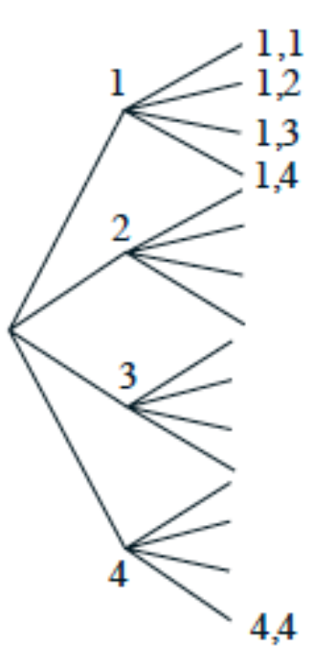
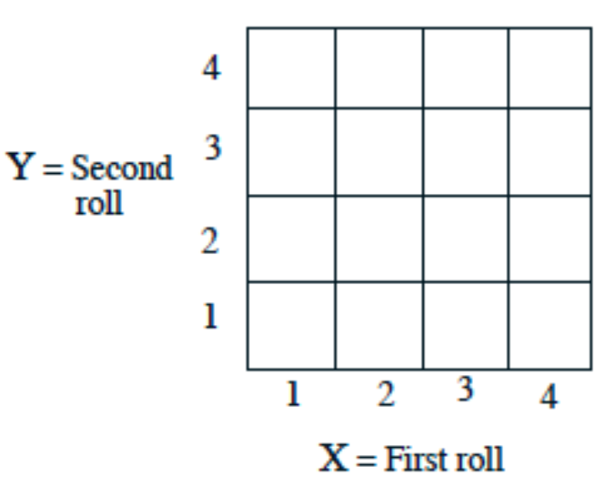
Probability – Sample Space
Experiment: we roll a 4 sided-die twice
Discrete sample space
List
  {(1,1), (1,2) …}
table
tree

Slide 10
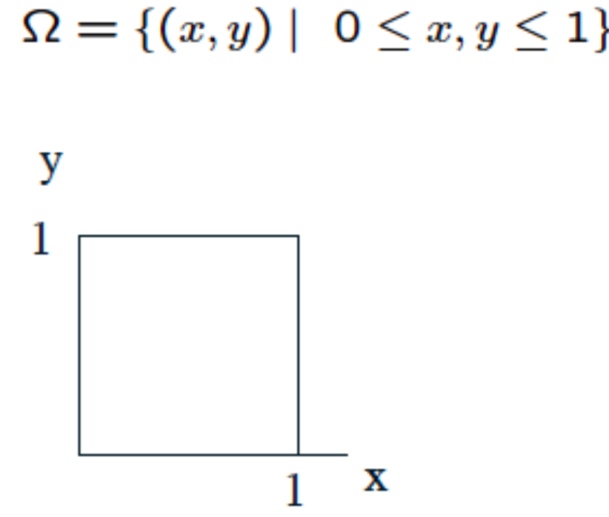
Probability – Sample Space
Experiment: DS221 and batch33 class today
Continuous sample space

Slide 11
Sample Space depends on Experiment
Toss a fair coin
  {H, T}
Toss a fair coin twice
  {HH, HT, TH, TT}
Toss until head appears
  {H, TH, TTH, …}

Slide 12
Sample Space depends on Experiment
Drawing 2 socks one at a time from a bag containing 1 blue sock, 1 orange sock and 1 white sock with replacement.
Question: What is the number of unique outcomes in the sample space?

Slide 13
Sample Space depends on Experiment
Drawing 2 socks one at a time from a bag containing 1 blue sock, 1 orange sock and 1 white sock with replacement.
Question: What is the number of unique outcomes in the sample space?
Outcomes
  {B-sock, O-sock, W-sock}
Unique outcomes in sample space
  {BB, BO, BW, OO, OW, OB, WW, WB, WO}

Slide 14
Sample Space depends on Experiment
Drawing 2 socks one at a time from a bag containing 1 blue sock, 1 orange sock and 1 white sock without replacement.
Question: What is the number of unique outcomes in the sample space?
Outcomes
  {B-sock, O-sock, W-sock}
Unique outcomes in sample space
  {BO, BW, OW, OB, WB, WO}

Slide 15
Sample Space in Real Life
Any thoughts?

Slide 16
Sample Space in Real Life
Any thoughts?
A bus arriving time
Possible mutations in gene
Weather forecasting
Classroom seating arrangements
Weekly students mess menu

